Slide 1
미래차 부트캠프 On-device AI
Lecture 6: Polling and Interrupt
Jong Hwan Ko
Associate Professor
SungKyunKwan University, Korea
Department of Electrical and Computer Engineering
jhko@skku.edu

Slide 2
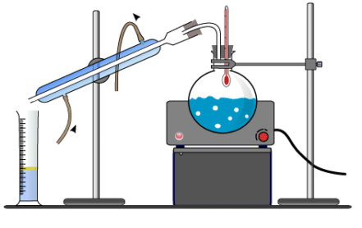
4. Knowledge Distillation – Contents
Intuition
Procedure
Concept of temperature
What to match?

Slide 3
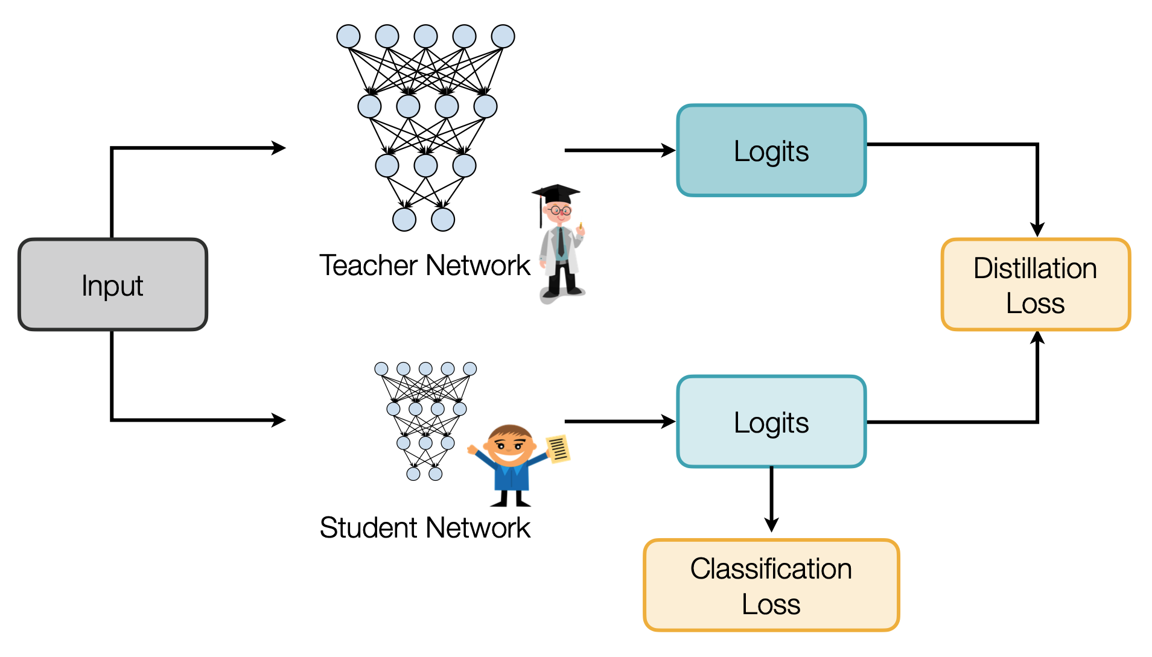
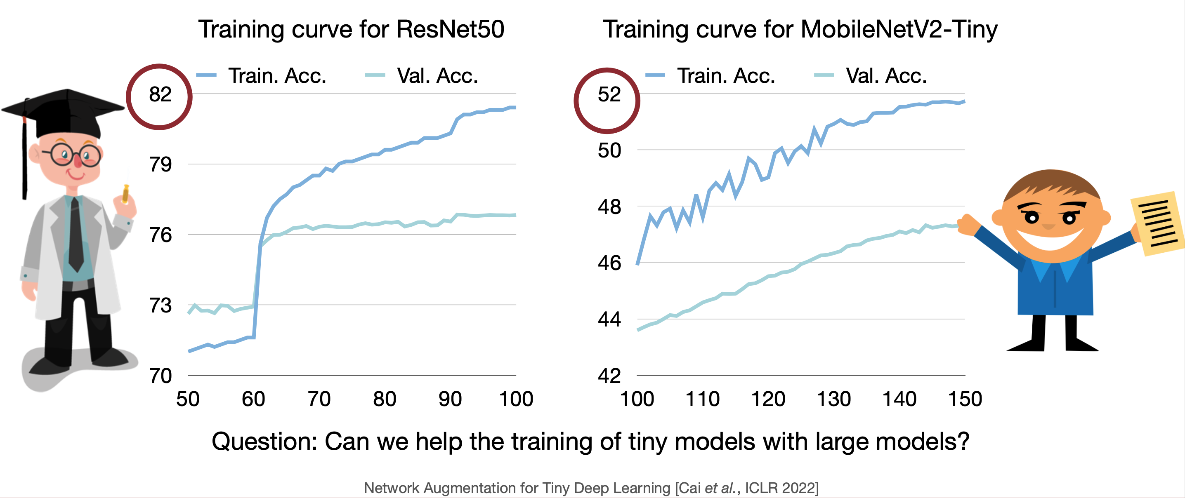
4. Knowledge Distillation
Tiny models are hard to train
Tiny models underfit large datasets
Adapted from “TinyML and Efficient Deep Learning Computing” Lecture (Fall 2024) by Prof. Song Han (MIT)

Slide 4
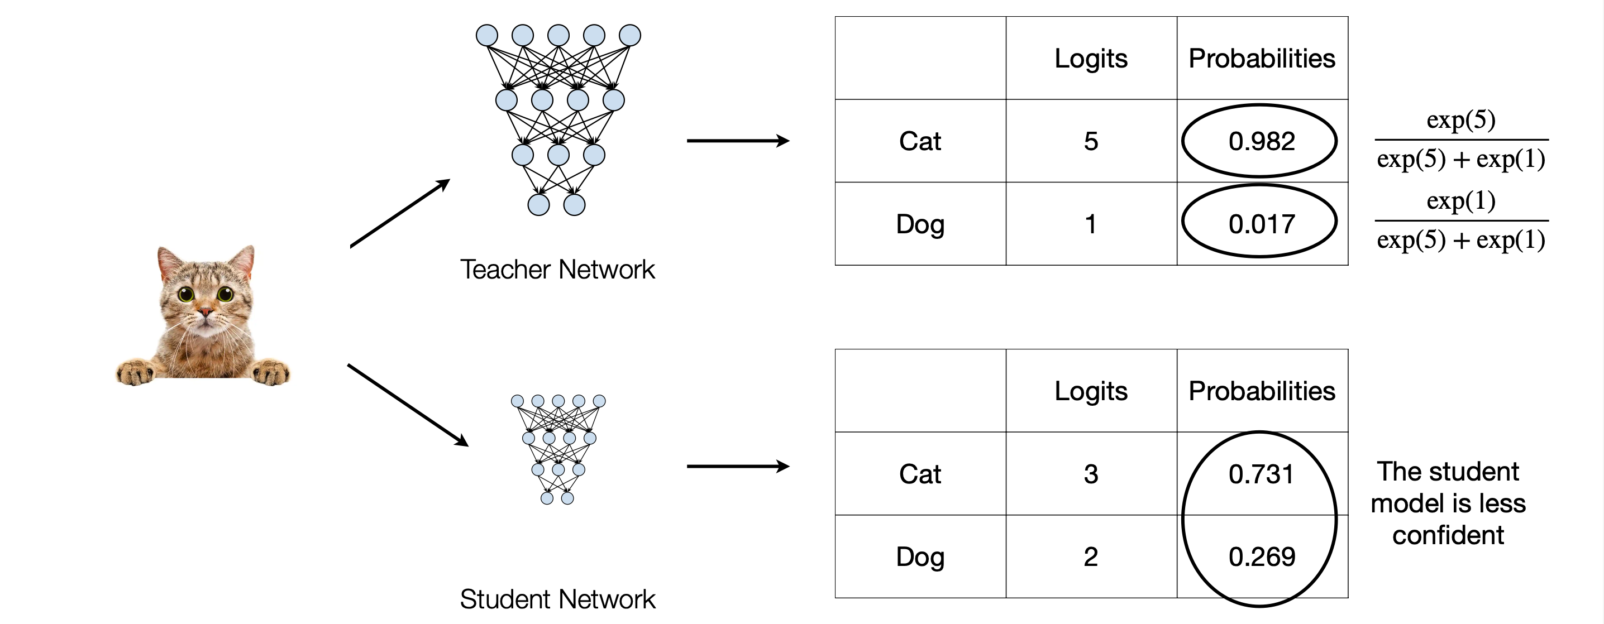
4. Knowledge Distillation
Intuition
Matching prediction probabilities between teacher and student
Adapted from “TinyML and Efficient Deep Learning Computing” Lecture (Fall 2024) by Prof. Song Han (MIT)

Slide 5
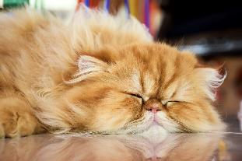
4. Knowledge Distillation
Matching Prediction Probabilities
Logits (z)
Probabilities (q)
Image
5 x 1
5 x 1
224 x 224 x 3
Neural Network
0.3
0.11
Input
Layer
(conv)
Hidden Layers
(conv + pool layers)
Output Layer
(FC)
Softmax
0.9
0.21
1.9
0.54
0.1
0.09
Loss Function
0.2
0.10
Key observation: Hard targets have no information about wrong classes
Soft targets have information about wrong classes
Where do we get them from?
(Soft) Targets
(Hard) Targets
0.03
car
0
0.25
dog
0
0.70
cat
1
0.02
bus
0
0.01
boat
0
Adapted from “Machine Learning Hardware and Systems” Lecture (Fall 2024) by Prof. M. Abdelfattah (Cornell Tech)

Slide 6
4. Knowledge Distillation
Matching Prediction Probabilities
Logits (z)
Probabilities (q)
5 x 1
5 x 1
Neural Network
Small Neural Network
0.3
0.11
Softmax
0.9
0.21
Image
Student
1.9
0.54
Backprop
224 x 224 x 3
0.1
0.09
Loss
Function
0.2
0.10
(Soft) Targets
Transfer set: subset of training data
Large Neural Network
0.1
Softmax
0.03
0.7
0.25
Teacher
2.9
0.70
Trained
0.2
0.02
0.1
0.01
Adapted from “Machine Learning Hardware and Systems” Lecture (Fall 2024) by Prof. M. Abdelfattah (Cornell Tech)

Slide 7
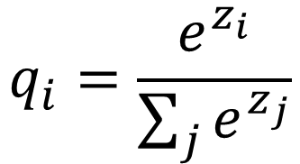
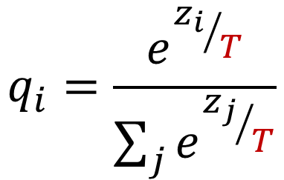
4. Knowledge Distillation
Concept of temperature
z | q [T=1] | q [T=10]
-1.1 | 0.007 | 0.171
1.4 | 0.087 | 0.219
3.7 | 0.880 | 0.276
0.1 | 0.024 | 0.193
-3.0 | 0.001 | 0.141
Recall: Softmax function:
Softmax with temperature:
Probability
Additional hyper-parameter: T → exposes more “dark knowledge”
T=10
T=5
T=1
Classes
Adapted from “Machine Learning Hardware and Systems” Lecture (Fall 2024) by Prof. M. Abdelfattah (Cornell Tech)

Slide 8
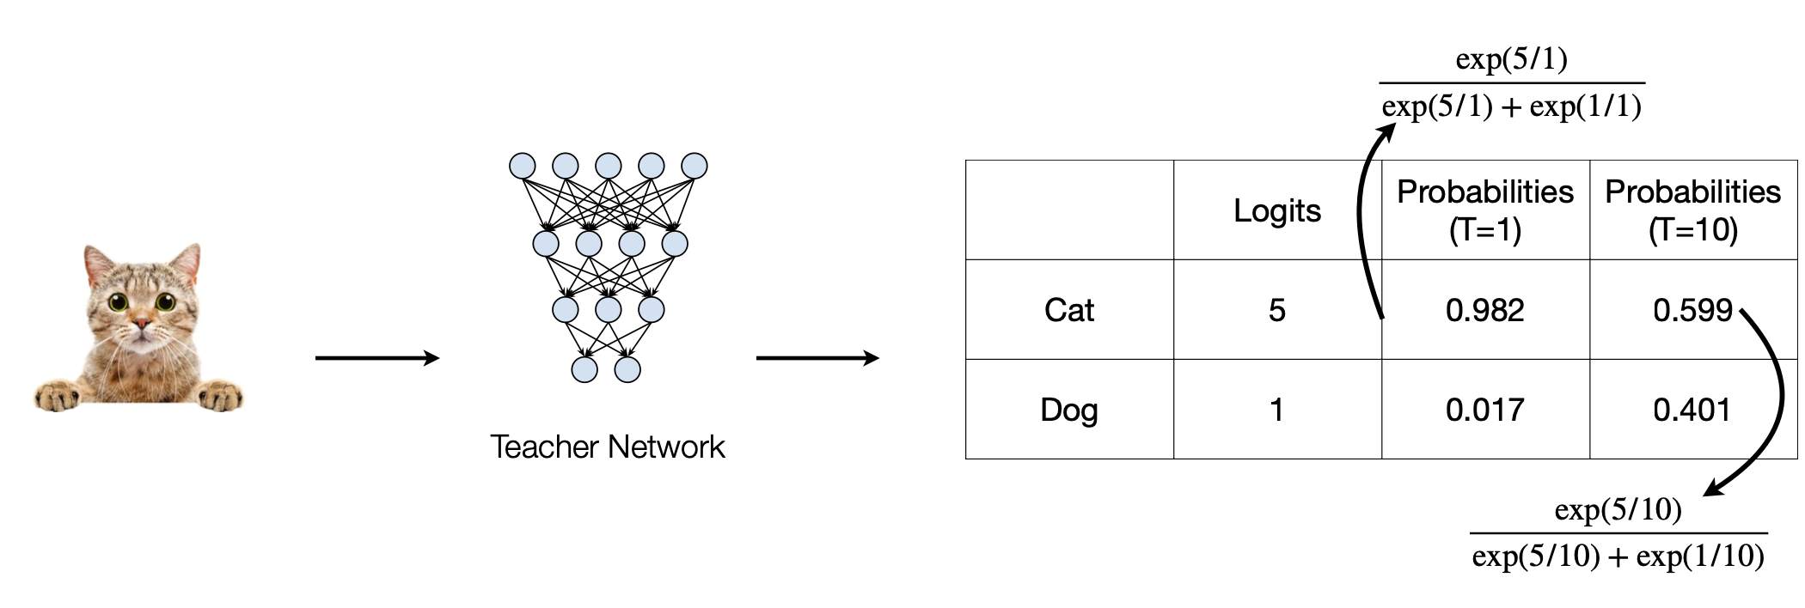
4. Knowledge Distillation
Concept of temperature
Adapted from “TinyML and Efficient Deep Learning Computing” Lecture (Fall 2024) by Prof. Song Han (MIT)

Slide 9
4. Knowledge Distillation - What to match?
Output logits
Intermediate weights
Intermediate features
Gradients (Attention maps)
Sparsity patterns

Slide 10
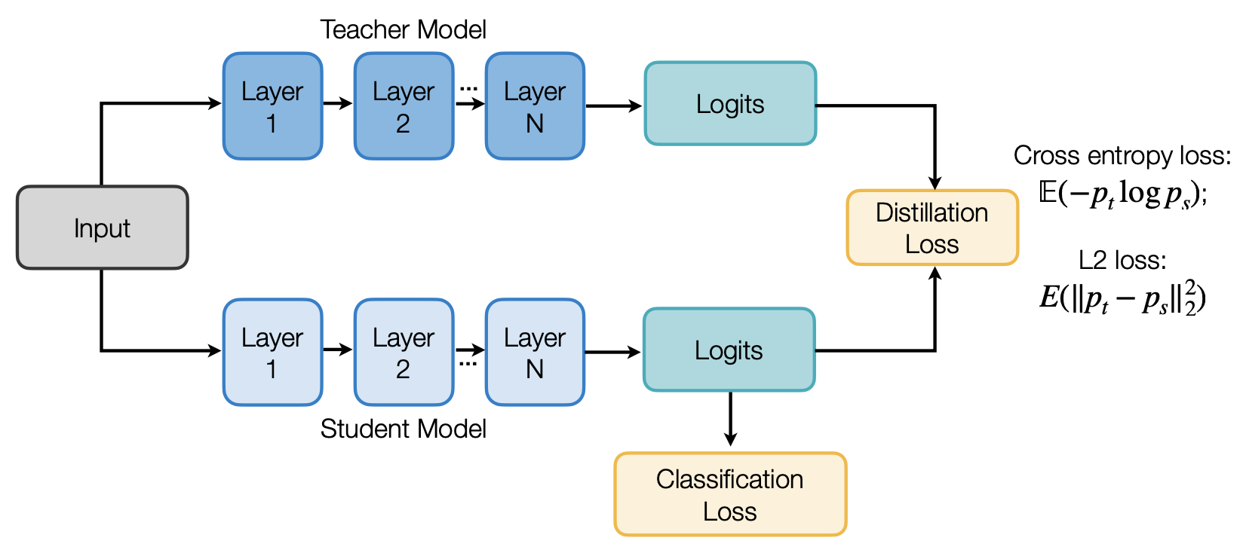
4. Knowledge Distillation – What to Match?
Matching output logits
Distilling the Knowledge in a Neural Network [Hinton et al., NeurIPS Workshops 2014]
Do Deep Nets Really Need to be Deep? [Ba and Caruana, NeurIPS 2014]
Adapted from “TinyML and Efficient Deep Learning Computing” Lecture (Fall 2024) by Prof. Song Han (MIT)

Slide 11
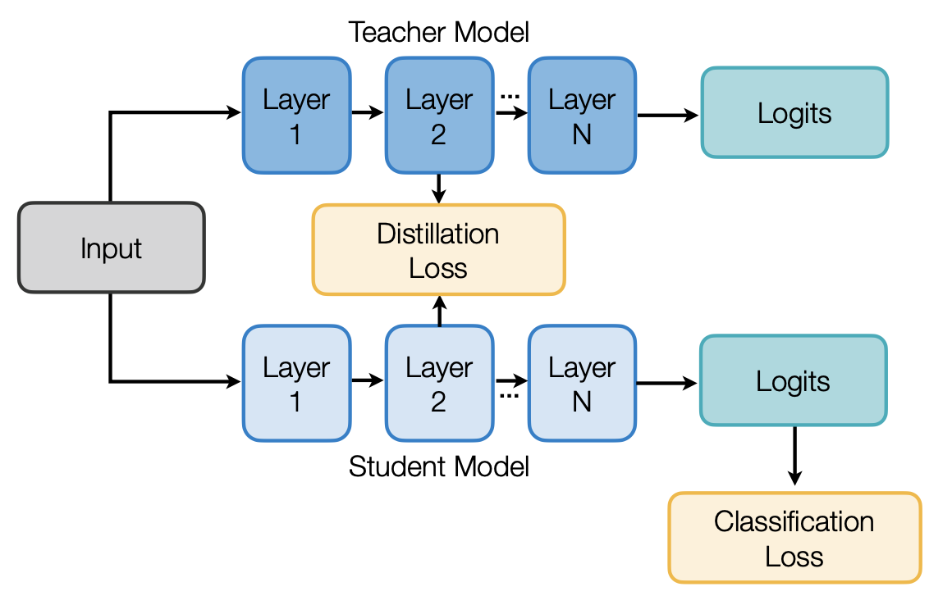
4. Knowledge Distillation – What to Match?
Matching intermediate weights
Knowledge Distillation: A Survey [Gou et al., IJCV 2020]
Adapted from “TinyML and Efficient Deep Learning Computing” Lecture (Fall 2024) by Prof. Song Han (MIT)
Notes:
이슈: dimension 차이를 어떻게 맞출지. 어댑터 같은거 씀

Slide 12
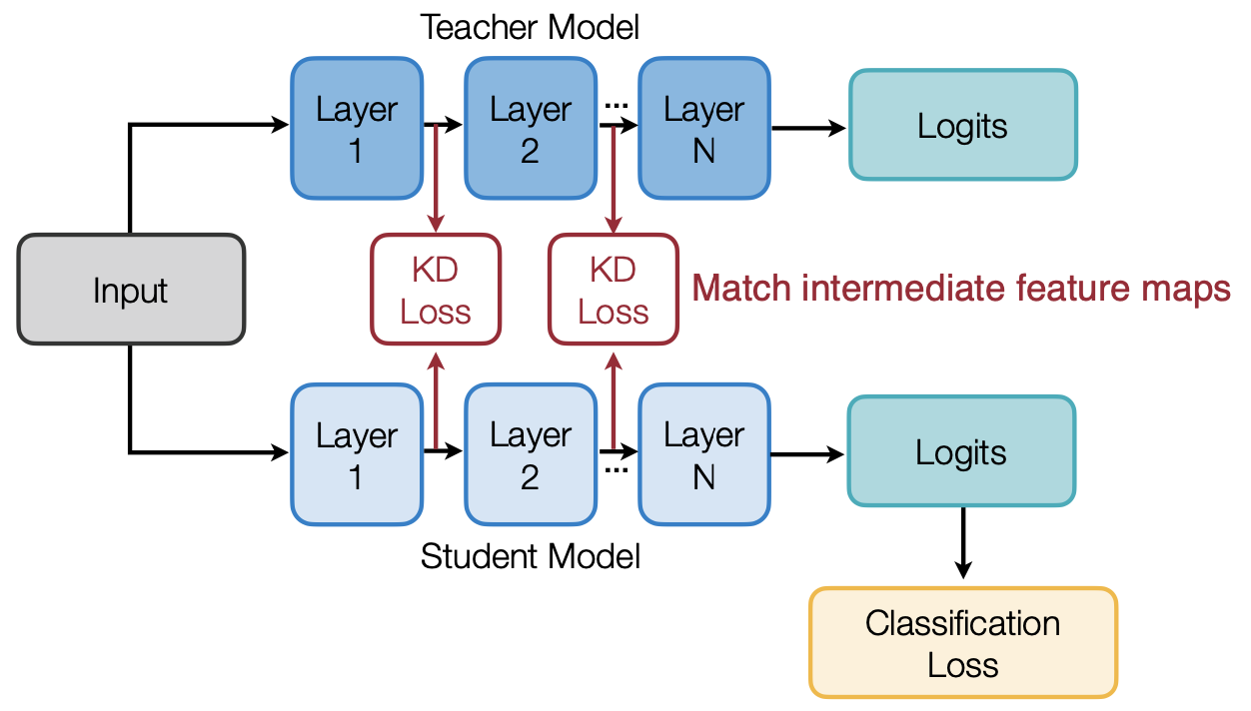
4. Knowledge Distillation – What to Match?
Matching intermediate features
Minimizing maximum mean discrepancy between feature maps
Intuition: teacher and student networks should have similar feature distributions, not just output probability distributions.
Like What You Like: Knowledge Distill via Neuron Selectivity Transfer [Huang and Wang, arXiv 2017]
Adapted from “TinyML and Efficient Deep Learning Computing” Lecture (Fall 2024) by Prof. Song Han (MIT)

Slide 13
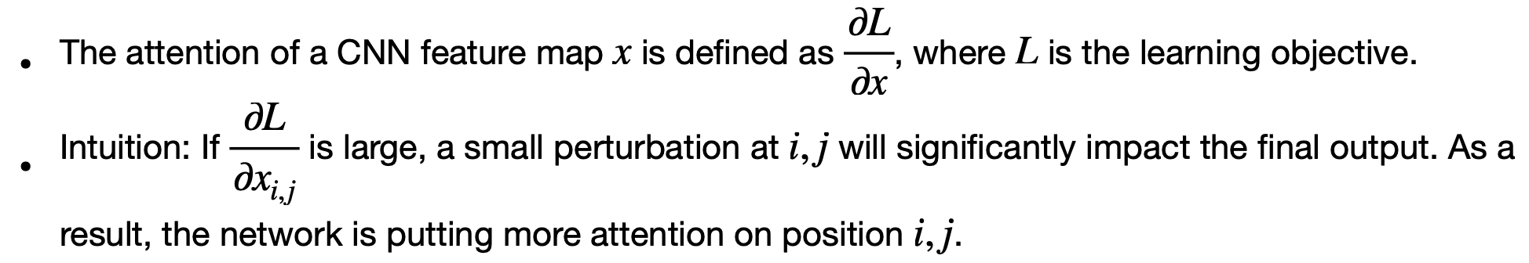
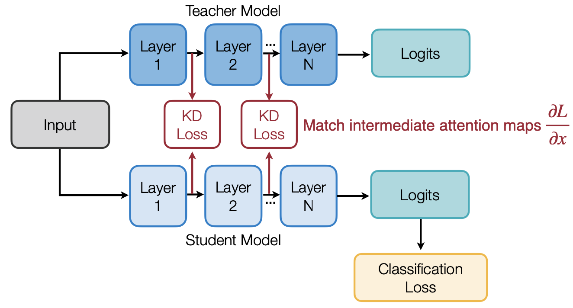
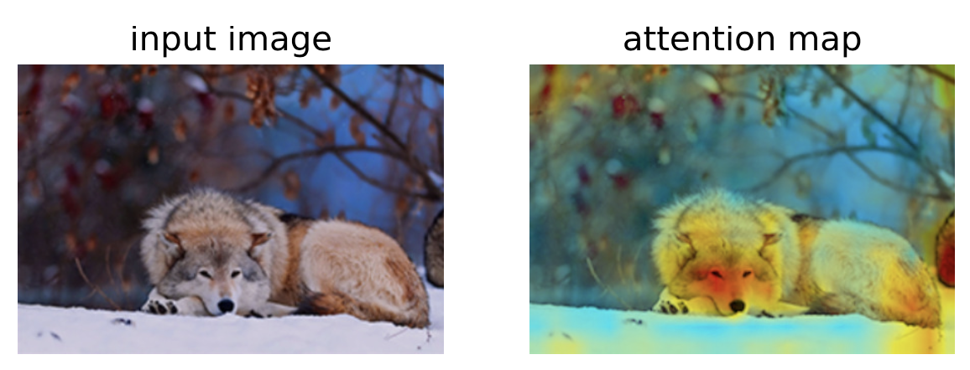
4. Knowledge Distillation – What to Match?
Matching intermediate attention maps
Gradients of feature maps are used to characterize “attention” of DNNs
Adapted from “TinyML and Efficient Deep Learning Computing” Lecture (Fall 2024) by Prof. Song Han (MIT)

Slide 14

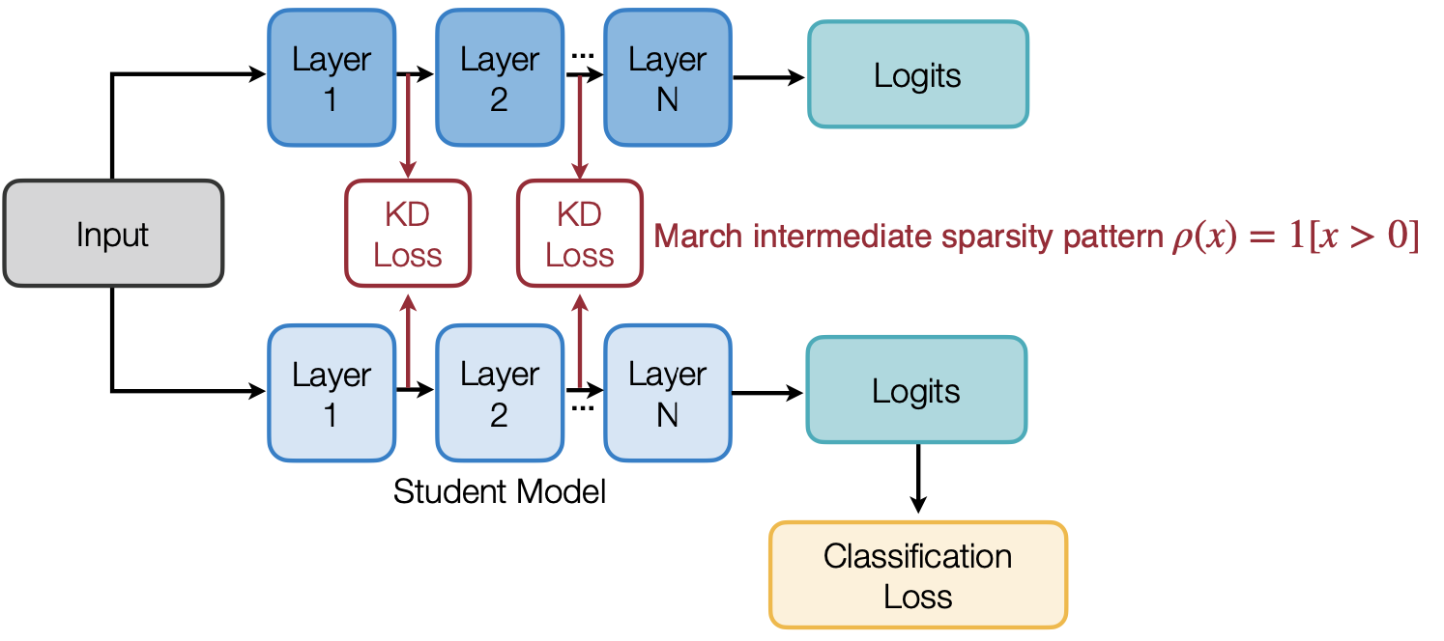
4. Knowledge Distillation – What to Match?
Matching sparsity patterns
Intuition: the teacher and student networks should have similar sparsity patterns after the ReLU activation
A neuron is activated after ReLU if its value is larger than 0, denoted by the indicator function
Knowledge Transfer via Distillation of Activation Boundaries Formed by Hidden Neurons [Heo et al., AAAI 2019]
Adapted from “TinyML and Efficient Deep Learning Computing” Lecture (Fall 2024) by Prof. Song Han (MIT)

Slide 15
Thank you!
Lecture 6: Polling and Interrupt
Questions or comments?
Jong Hwan Ko
SungKyunKwan University, Korea
Department of Information and Communication Engineering
jhko@skku.edu

